Slide 1

Topics in Applied Opmization
Deep Learning without Poor Local Minima
PROF. PAWAN KUMAR
TEAM-18
Irugula Hanish Reddy : 2021102005
Pradhith V.S.S: 2021102015
Monsoon 2023
December 5th, 2023

Slide 2
INTRODUCTION
The paper we have taken for the study is “Deep Learning without Poor Local Minima” written by Kenji Kawaguchi (from MIT) was taken from 30th Conference on Neural Information Processing Systems, 2016, Barcelona, Spain.
This paper focuses on the characteristics of loss function in deep linear networks and thus extending the discussion to non-linear networks as well and tells how this function can be optimized.
Monsoon 2023
December 5th, 2023

Slide 3
MOTIVATION
The training of deep neural networks is a fundamental task in the field of deep learning, involving the optimization of network parameters to minimize a defined loss function.
But the Loss function is non convex in weight parameters making it a non convex optimization problem.
So by using gradient descent method we cannot say directly that the solution obtained is global minima
Monsoon 2023
December 5th, 2023

Slide 4
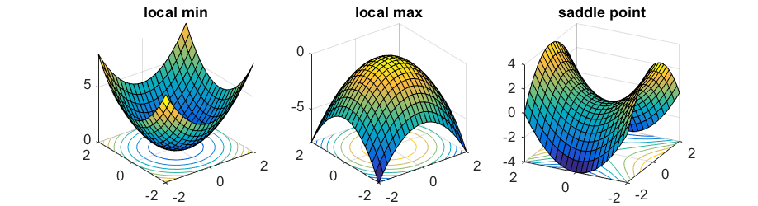
What are saddle points?
Saddle points are the critical points where the function has a local maximum along some directions and a local minimum along others at the critical point.
Monsoon 2023
December 5th, 2023

Slide 5
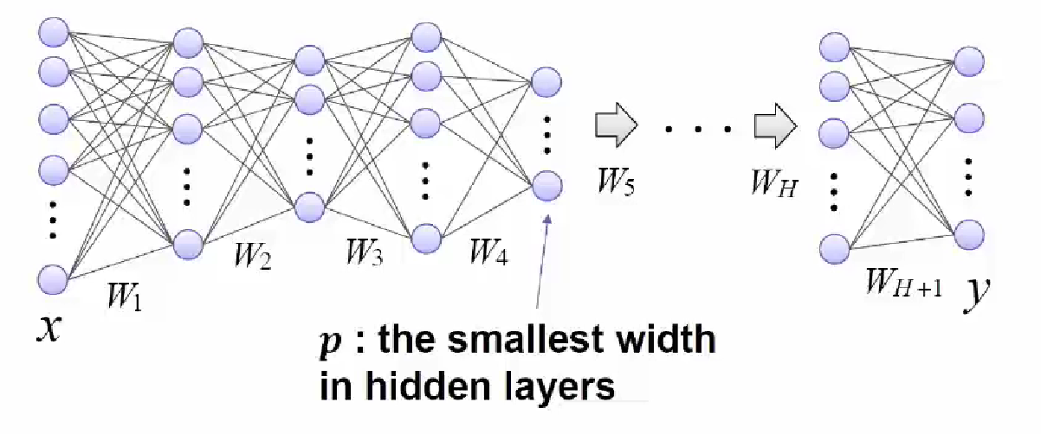
Deep Linear Networks
Monsoon 2023
December 5th, 2023

Slide 6
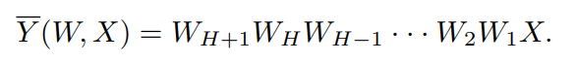
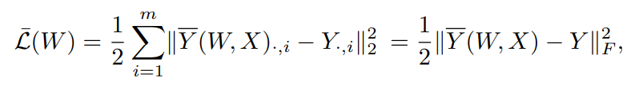
Forward Propagation
Output after the first layer is W1*X
Output after the second layer is W2*W1*X
Similarly we will get the output as
The squared error loss is
Monsoon 2023
December 5th, 2023

Slide 7
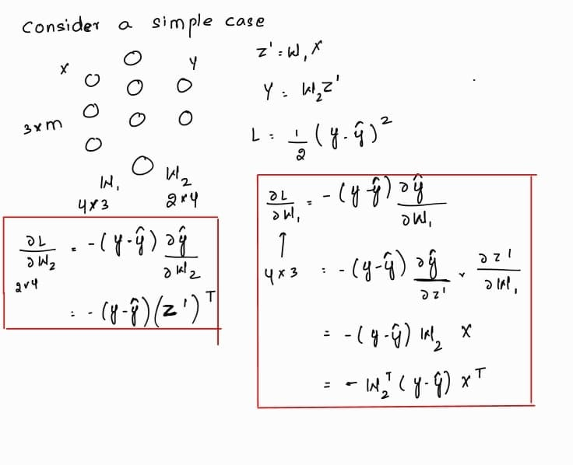
Back Propagation
The key step of backpropagation involves propagating the error backward through the network to update the weights.
The gradient of the loss with respect to each weight and bias is calculated using the chain rule of calculus.
Monsoon 2023
December 5th, 2023

Slide 8
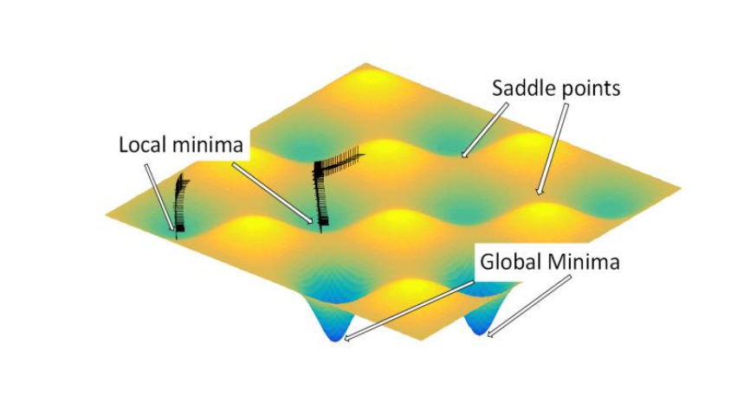
How does the Loss surface look like?
It can be seen from the figure that we can get stuck at Local Minima or at Saddle points
Monsoon 2023
December 5th, 2023

Slide 9
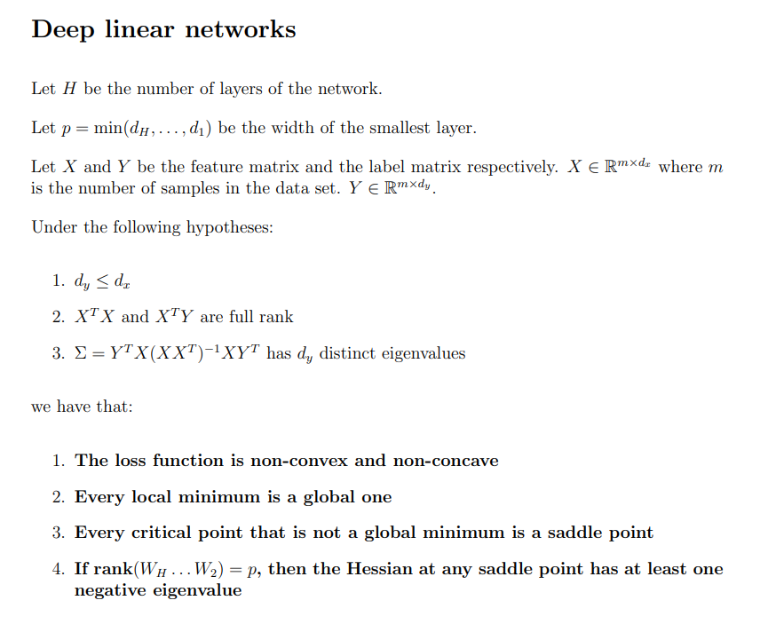
Loss Surface of Deep Linear Model
Monsoon 2023
December 5th, 2023

Slide 10
Why is the loss function non-convex?
For a simple linear model with H = 0, it is known that loss function is convex.
But for H >= 1, the loss function is not convex because of rank restriction due to the smallest width, p.
Also, another possible reason is due to effect of depth which involves interaction of weights in different layers.
Monsoon 2023
December 5th, 2023

Slide 11
When is the loss function convex?
If the product of the weights from W_H to W2 layers is full rank i.e., equal to the minimum width of any layer in the network, the loss function is said to be convex.
In such case, the network can represent any linear transformation within the dimensionality constraints set by the layer widths.
Under this condition, the optimization problem becomes strongly convex.
Monsoon 2023
December 5th, 2023

Slide 12
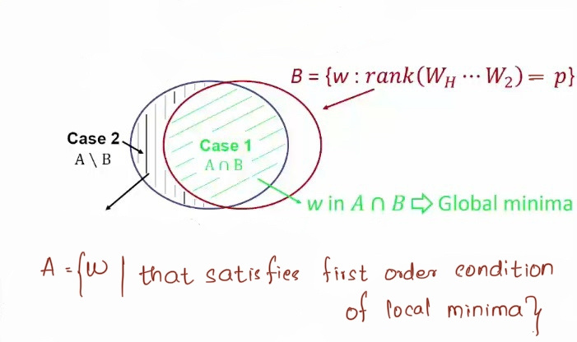
Rank condition for Saddle points
If the rank of product of the weights from W_H to W2 layers is equal to the minimum width of any layer in the network, then the Hessian at any saddle point has at least one (strictly) negative eigenvalue.
From the figure, it can be said that for w in case 1 i.e., A∩B, even if its a saddle point we have a negative eigen value so we can move in the eigen direction of negative eigen value.
Monsoon 2023
December 5th, 2023

Slide 13
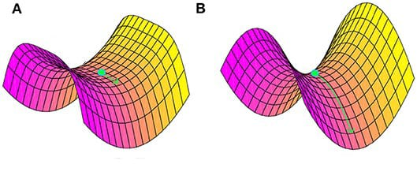
Bad saddle points
From the figure, it can be said that for w in case 2 are not bad local minima since there exists a decreasing direction in it’s neighborhood.
Instead, it can be said that w in A\B is a saddle point with no negative eigen value which are also called as bad saddle points.
Monsoon 2023
December 5th, 2023

Slide 14
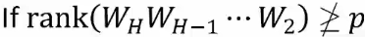
Effect of depth
For a three-layer networks (i.e., H = 1):
The Hessian at any saddle point has at least one negative eigen value.
For networks deeper than three layers (i.e., H >=2):
there exist saddle points at which the Hessian does not have any negative eigen value.
Monsoon 2023
December 5th, 2023

Slide 15
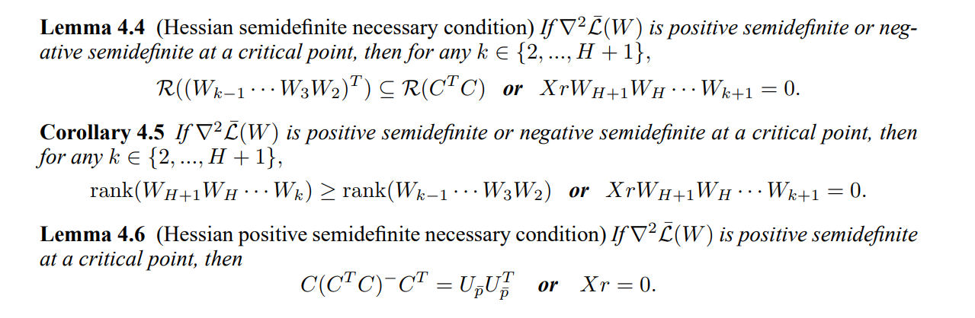
Proof Idea :
Monsoon 2023
December 5th, 2023

Slide 16
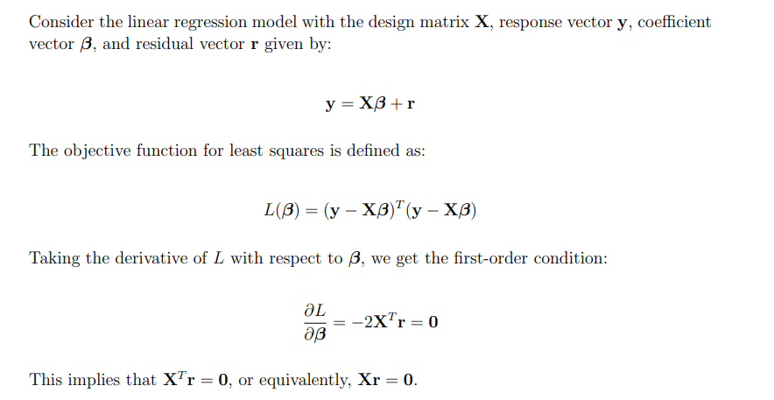
Proof Idea :
Monsoon 2023
December 5th, 2023

Slide 17
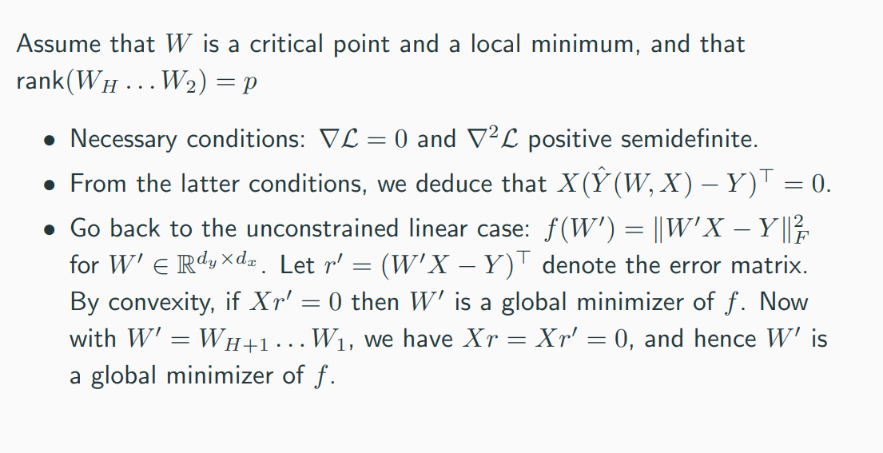
Proof Idea :
Monsoon 2023
December 5th, 2023

Slide 18
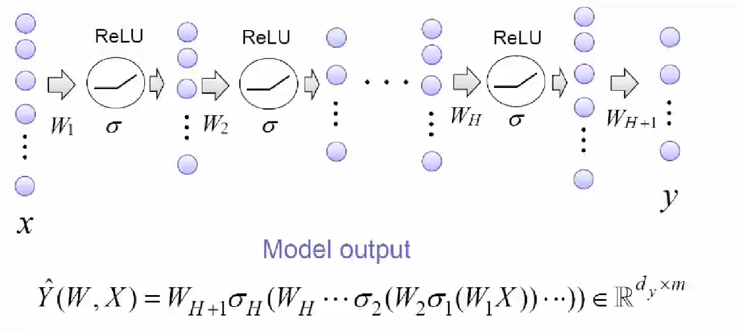
Deep Non-Linear Network
Here we have a activation layer which is non-llinear
Monsoon 2023
December 5th, 2023

Slide 19
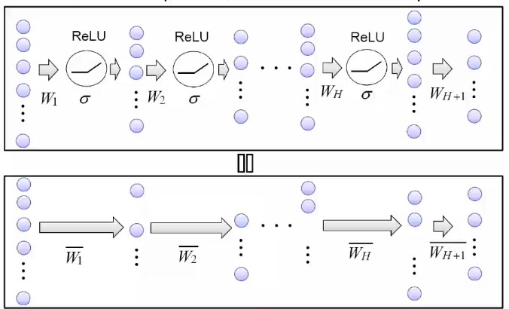
Deep Non-Linear Network as Linear Network
Under certain assumptions we can assume our non- linear network to be linear network.
Any set of assumptions that can reduce non-linear model to deep linear model immediatley leads to “no bad local minima” results and more.
Monsoon 2023
December 5th, 2023

Slide 20
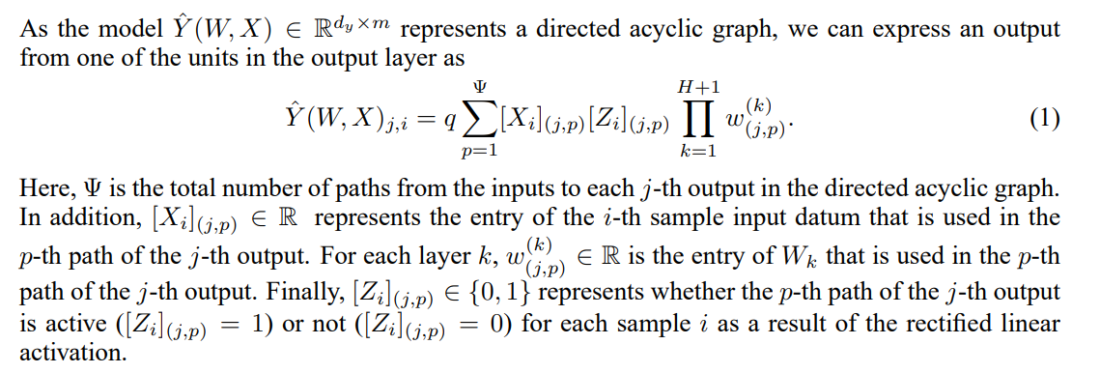
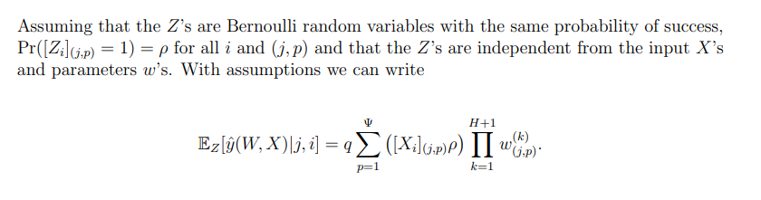
Assumptions for Relu Non-Linear Network
Monsoon 2023
December 5th, 2023

Slide 21
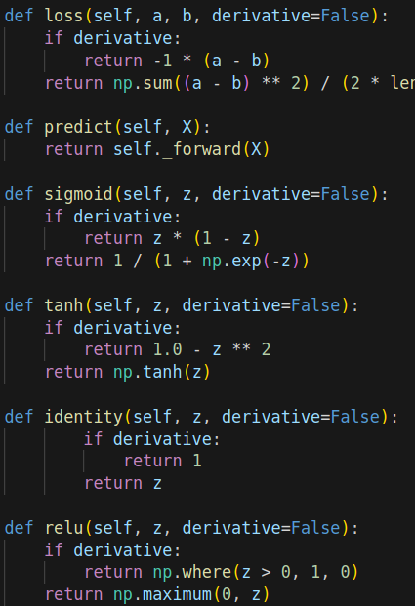
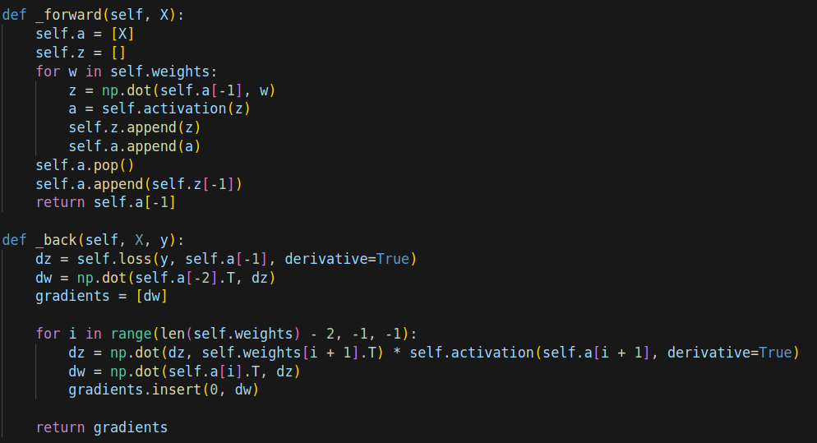
Results
Monsoon 2023
December 5th, 2023

Slide 22
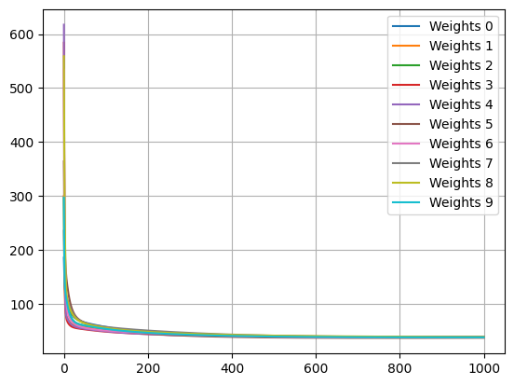
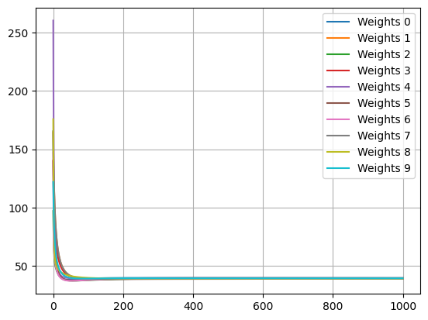
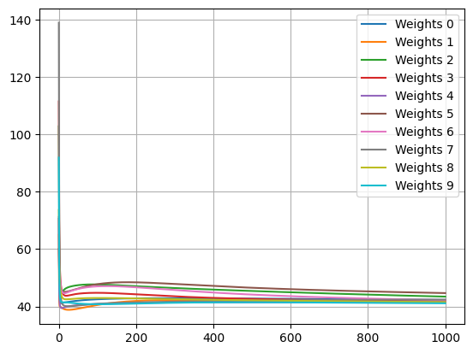
Results-Linear Network
1 hidden layer
2 hidden layers
3 hidden layers
Monsoon 2023
December 5th, 2023

Slide 23
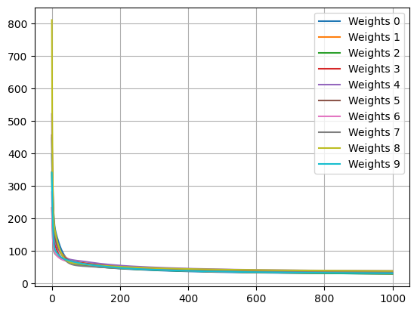
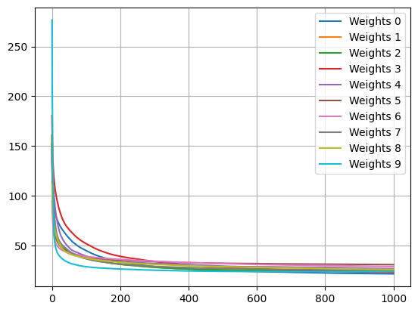
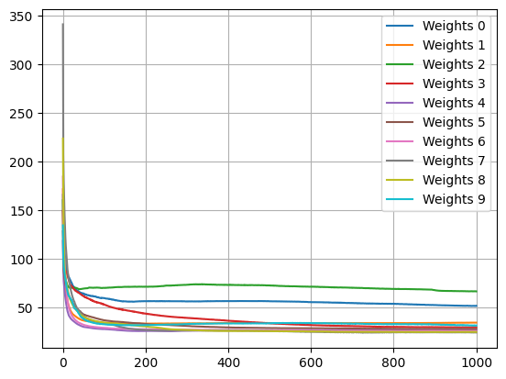
Results-N0n-Linear Network(RELU)
1 hidden layer
2 hidden layers
3 hidden layers
Monsoon 2023
December 5th, 2023

Slide 24
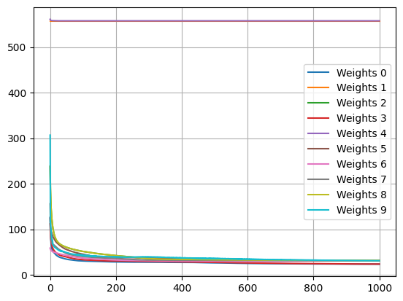
Results
5 hidden layers
We can see that a weight is stuck at a saddle point as its loss is not decreasing
Monsoon 2023
December 5th, 2023

Slide 25
Conclusion
Depth does not create bad local minima.
Depth creates bad saddle points.
Monsoon 2023
December 5th, 2023

Slide 26
THANK YOU
TEAM-18
Irugula Hanish Reddy : 2021102005
Pradhith V.S.S: 2021102015
Monsoon 2023
December 5th, 2023

